Slide 1
Lung Health in europe facts and figures

Slide 2
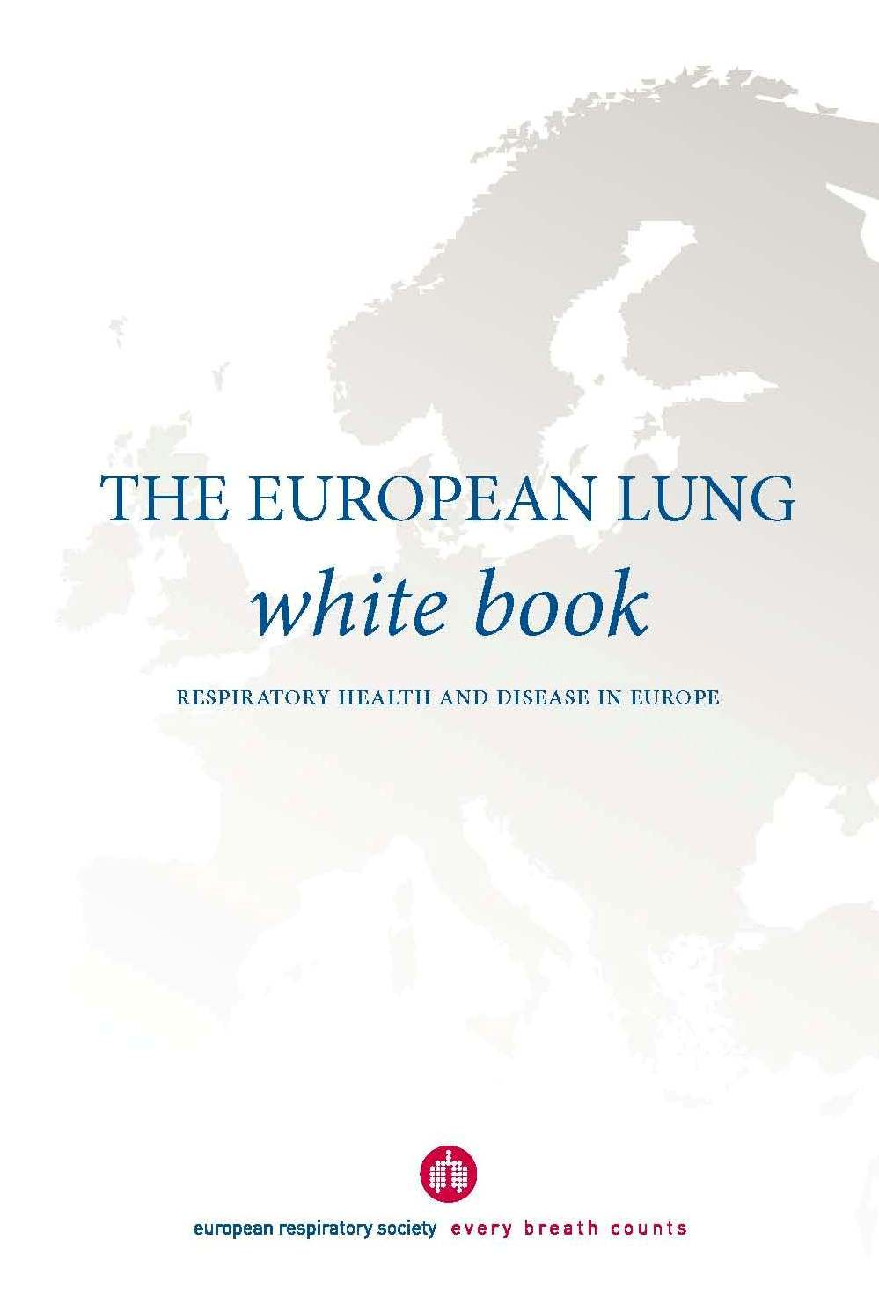
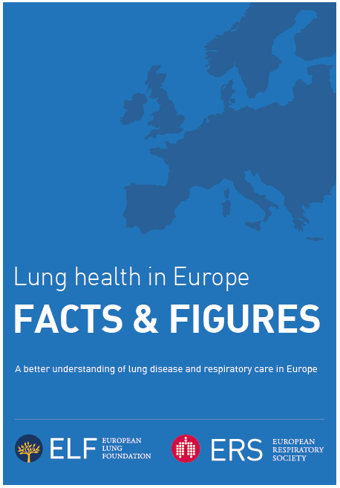

Slide 3
KEY AIMS
‘Lung Health in Europe – Facts and Figures’ is a concise version of the European Respiratory Society publication, The European Lung White Book.
The key aims of both publications are:
To raise awareness of respiratory diseases and their impact on the health of the European population
To reach out to the public, patients and the media to help increase understanding of the broad nature of respiratory health
To provide a tool to influence policymakers for the benefit of lung health

Slide 4
Burden

Slide 5
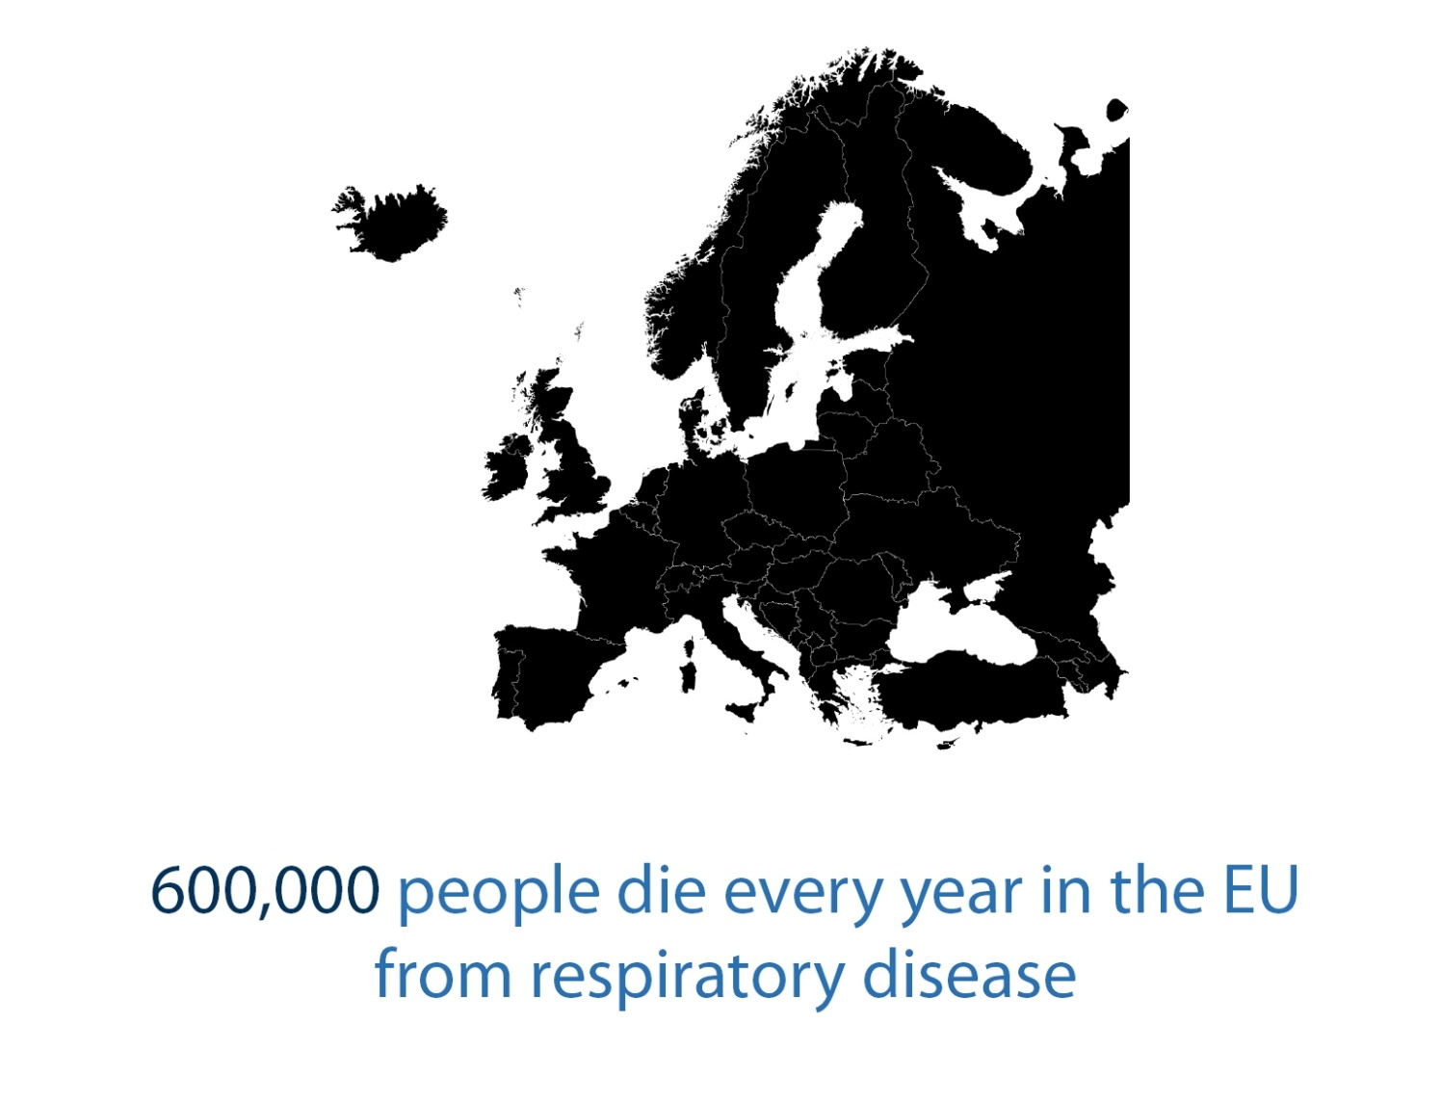

Slide 7
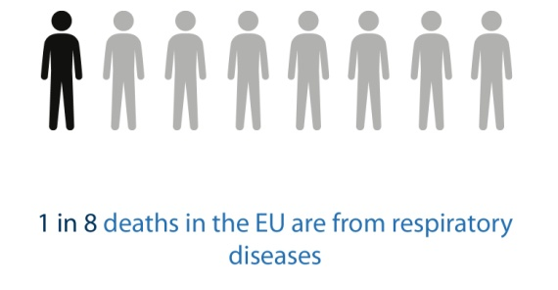

Slide 8
Cost

Slide 9
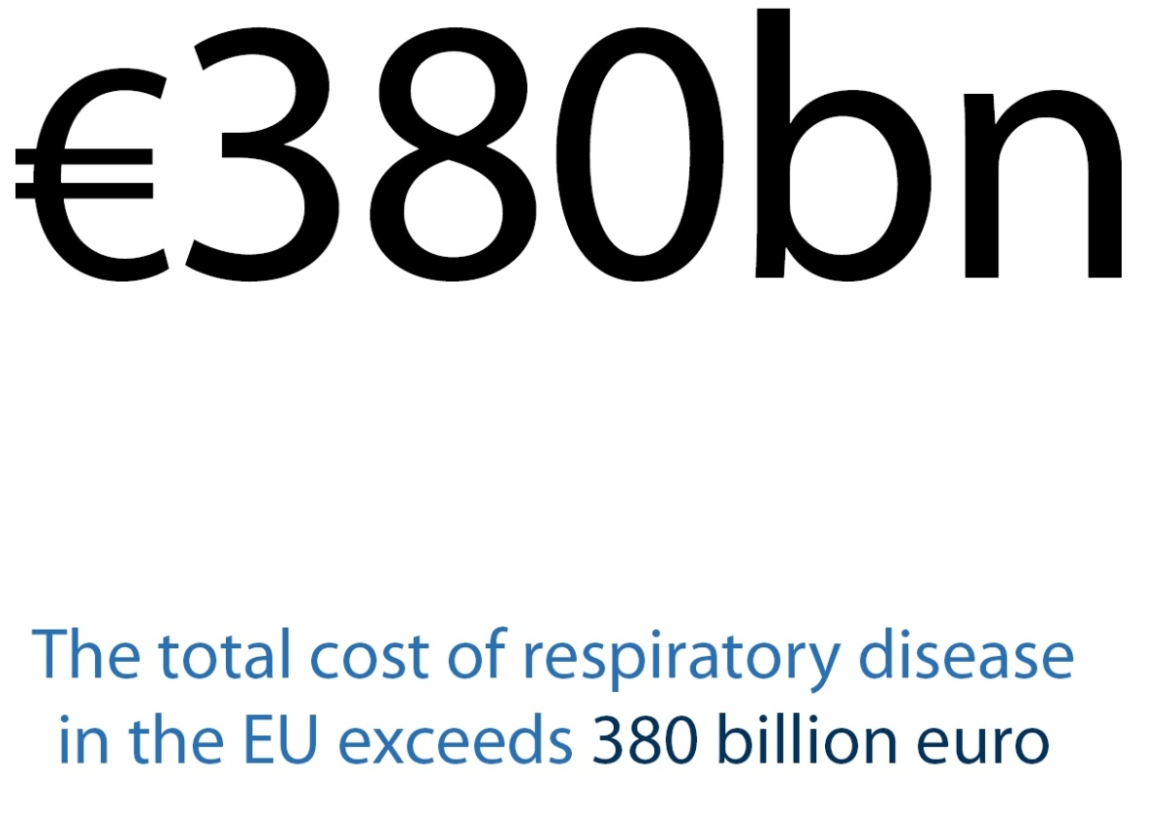

Slide 10
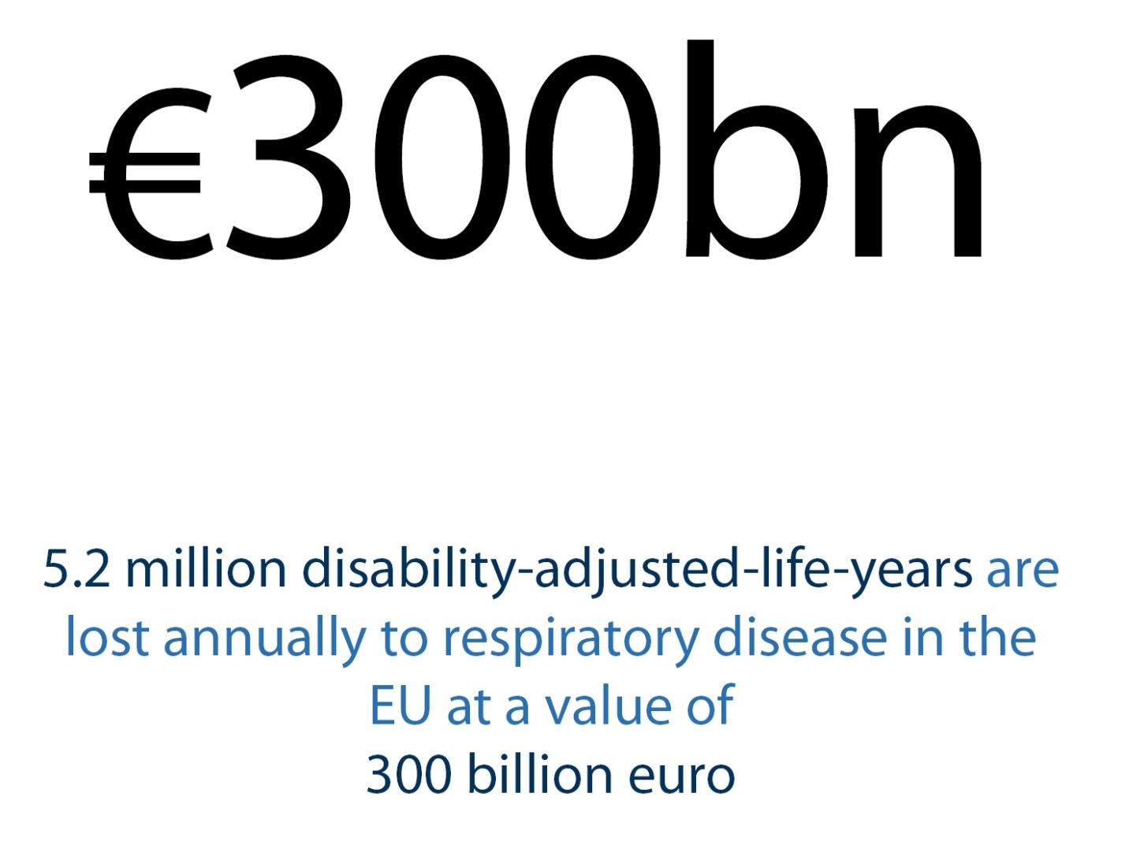

Slide 11
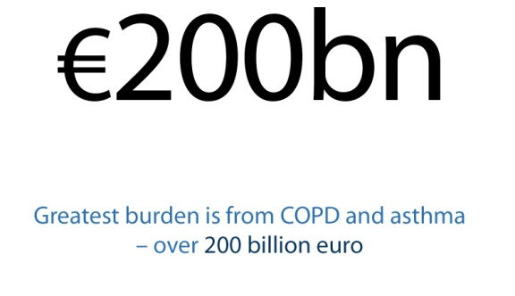

Slide 12
Diseases

Slide 13
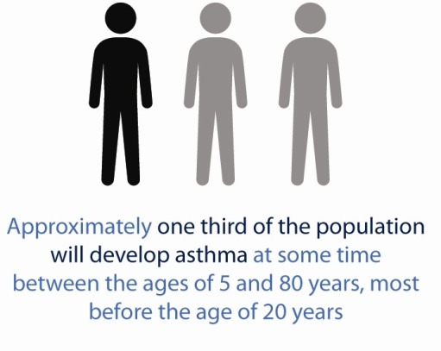

Slide 15
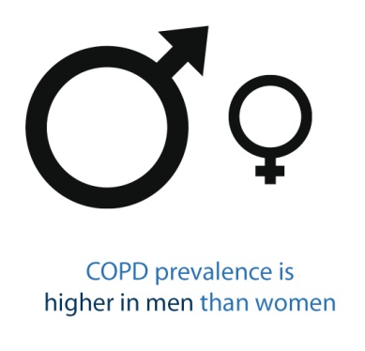

Slide 16
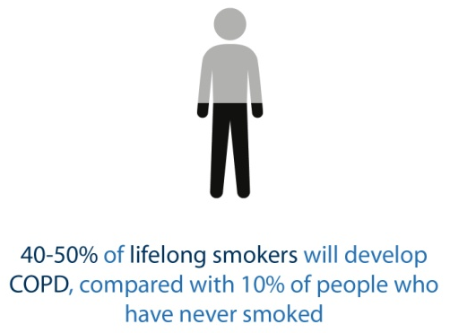

Slide 20
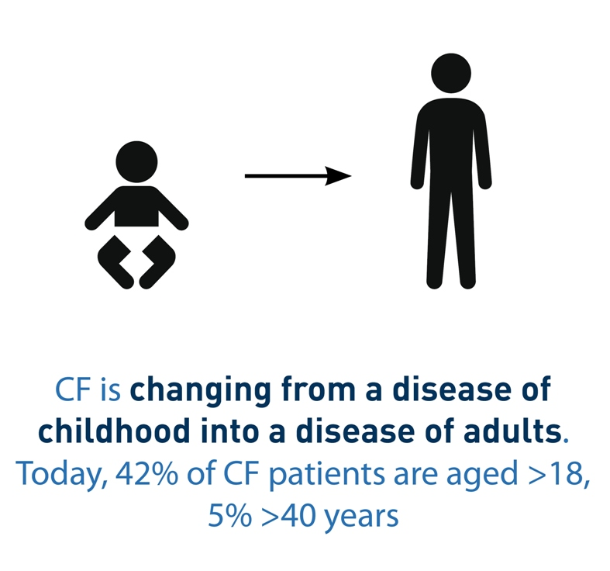

Slide 24
Risk factors

Slide 25
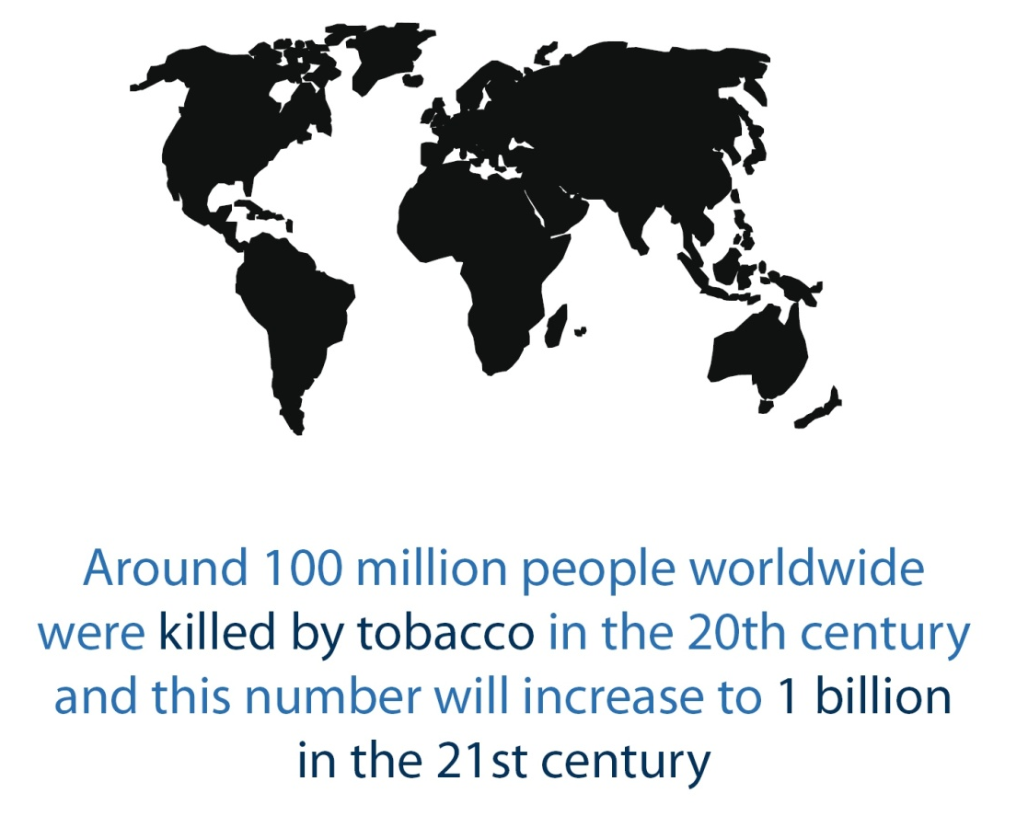

Slide 26
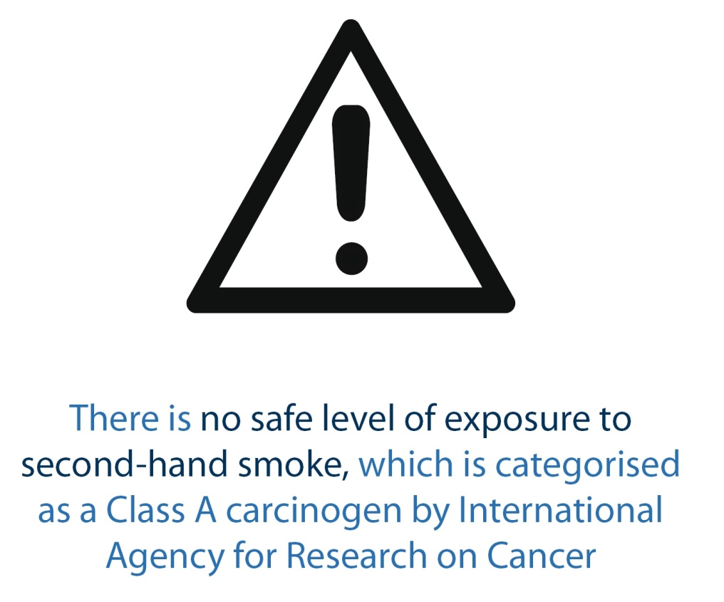

Slide 27
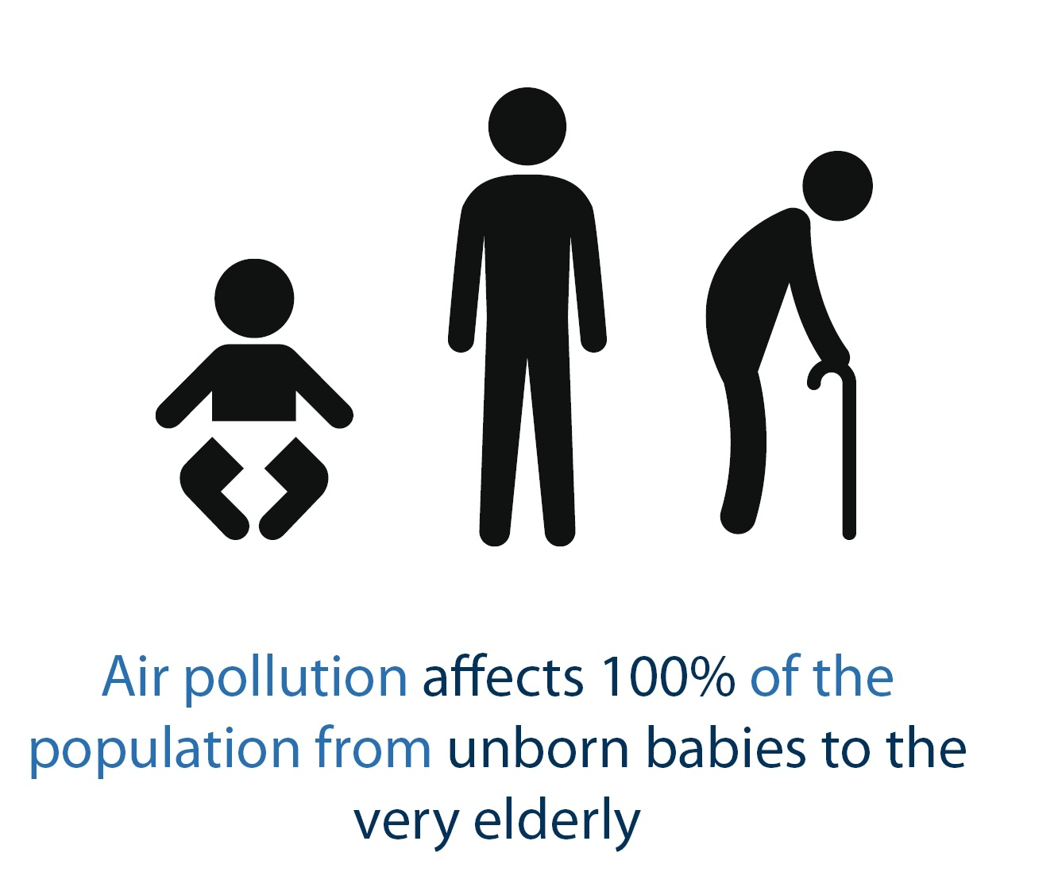

Slide 28
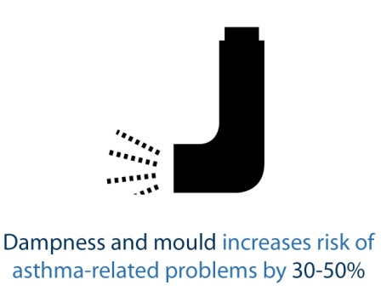

Slide 29
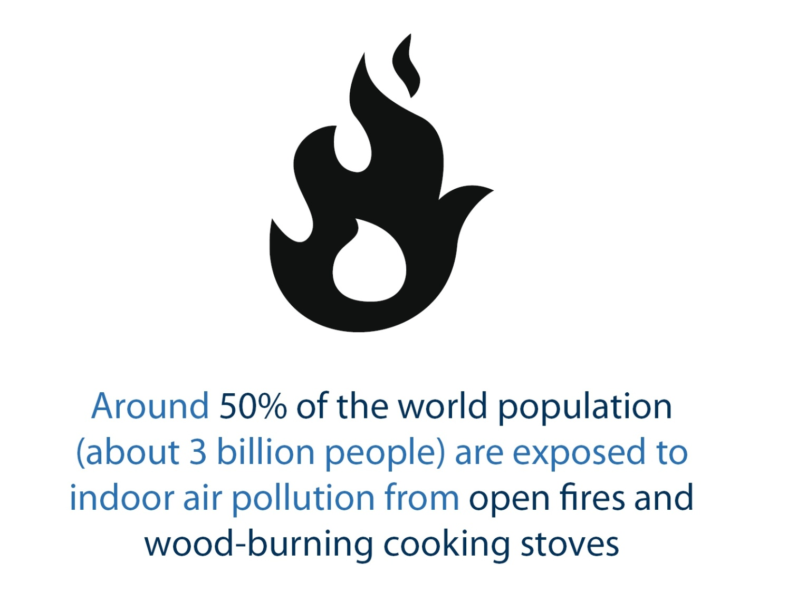

Slide 30
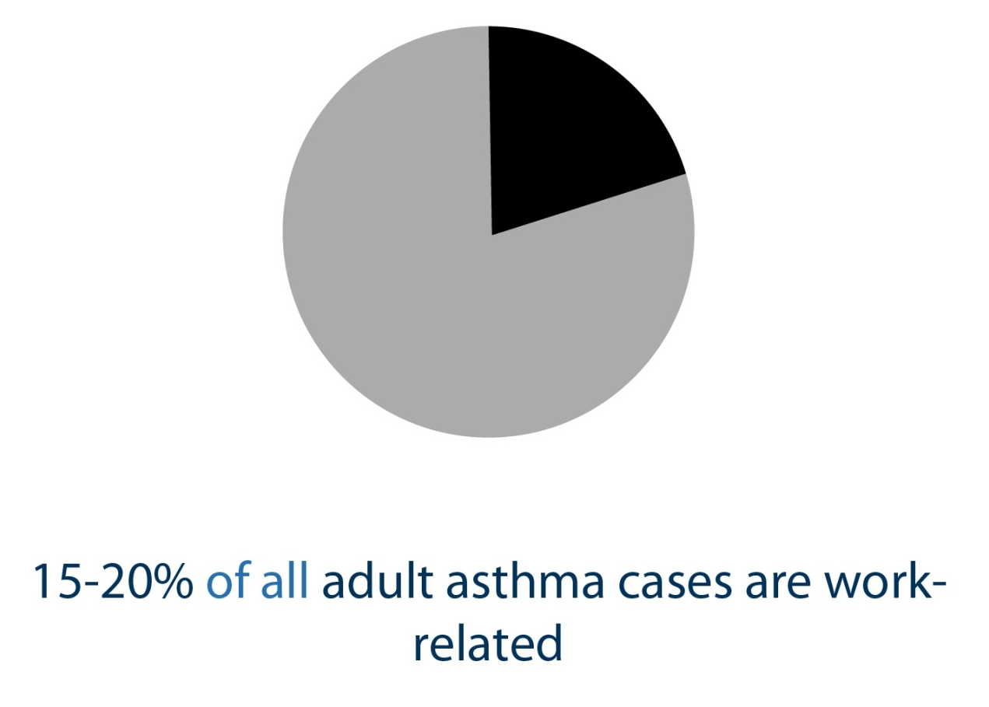

Slide 31
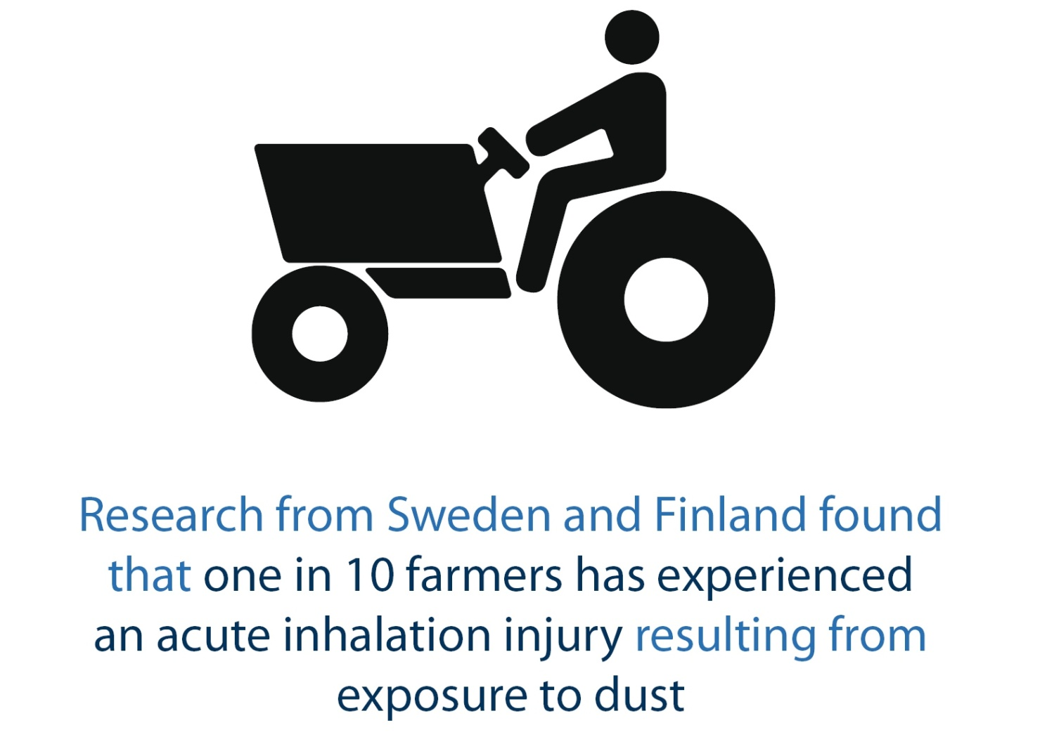

Slide 32
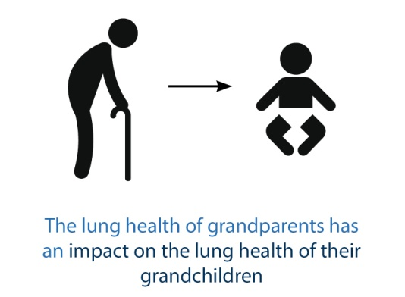

Slide 35
Copyright of ‘Lung Health in Europe – facts and figures’
This work by European Lung Foundation is licensed under a Creative Commons Attribution-NonCommercial 4.0 International licence
You are free to:
Share — copy and redistribute the material in any medium or format
Adapt — remix, transform, and build upon the material
The licensor cannot revoke these freedoms as long as you follow the license terms.
Under the following terms:
Attribution — You must give appropriate credit, provide a link to the license (www.erswhitebook.org), and indicate if changes were made. You may do so in any reasonable manner, but not in any way that suggests the European Respiratory Society/European Lung Foundation endorses you or your use.
NonCommercial — You may not use the material for commercial purposes.
No additional restrictions — You may not apply legal terms or technological measures that legally restrict others from doing anything the license permits

